Slide 1
Understanding the Child Welfare System

Slide 2
The Florida Department of Children and Families (DCF)
The Florida Department of Children and Families (DCF) is committed to the well-being of children and their families.
The Department’s Child Welfare Program works in partnership with local communities, courts and tribes to ensure the safety, timely permanency and well-being of children.
Notes:
Our responsibilities encompass a wide-range of services, including – among other things – assistance to families working to stay safely together or be reunited, foster care, youth and young adults transitioning from foster care to independence, and adoption.
The people who work in the Child Welfare Program conduct, supervise and administer programs for dependent children and their families.

Slide 3
Child Welfare Program Goals:
Prevention of family separation
Protection of children
Reunification of families
Notes:
The prevention of separation of children from their families.
The protection of children alleged to be dependent or dependent children including provision of emergency and long-term alternate living arrangements.
The reunification of families who have had children placed in foster homes or institutions.

Slide 4
Child Welfare Program Goals:
Permanent placement
Transition to self-sufficiency
Preparation of young adults
Notes:
The permanent placement of children who cannot be reunited with their families or when reunification would not be in the best interest of the child.
The transition to self-sufficiency for older children who continue to be in foster care as adolescents.
The preparation of young adults that exit foster care at age 18 to make the transition to self-sufficiency as adults.

Slide 5
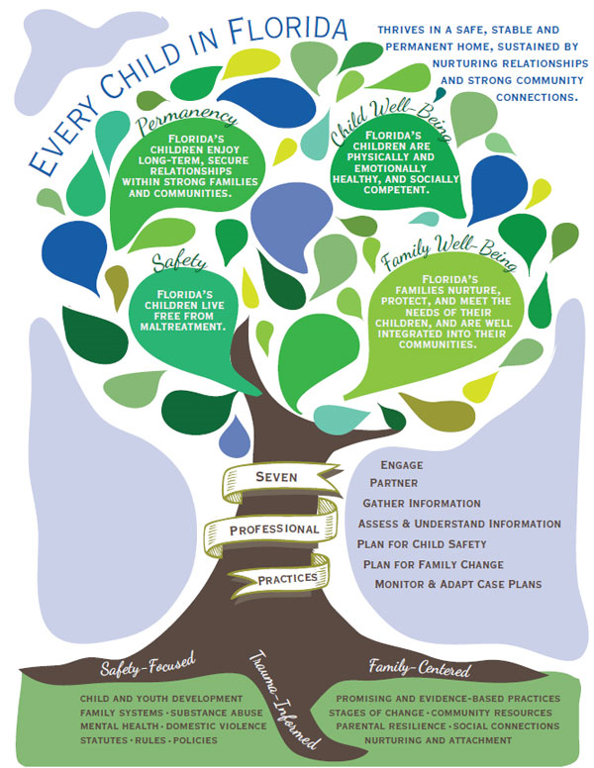
Notes:
This tree represents 7 professional practices by child welfare professionals:
Permanency
Safety
Child well-being
Family well-being
Root of it all is:
Safety-focused
Trauma informed
Family Centered

Slide 6
The Abuse Hotline
1-800-962-2873 (1-800-96-ABUSE)
https://www.myflfamilies.com/contact/
Notes:
What prompts the beginning of a family’s involvement with the child welfare system is either a call or online report submission to the abuse hotline.

Slide 7
Triggering The System: THE HOTLINE
Examples:
Daycare worker finds a bag of marijuana in a diaper bag.
Therapist calls due to minor client disclosing sexual abuse.
Teacher is concerned due to student having bruises on their body.
Notes:
The Hotline can be called by anyone who has concerns for a child’s wellbeing or safety. These are just a few examples of why the Hotline may be called…
Neighbor is worried due to the condition of the house.
Grandmother thinks child is not supervised due to parent substance use.
Police call during a domestic violence incident with children present.
Again, ANY concerned person in the community can make a report if they have any concerns for a child’s safety.

Slide 8
What does “Maltreatment” mean for Child Welfare?
Maltreatment means the type of abuse or neglect that was alleged against a parent or caregiver.

Slide 9
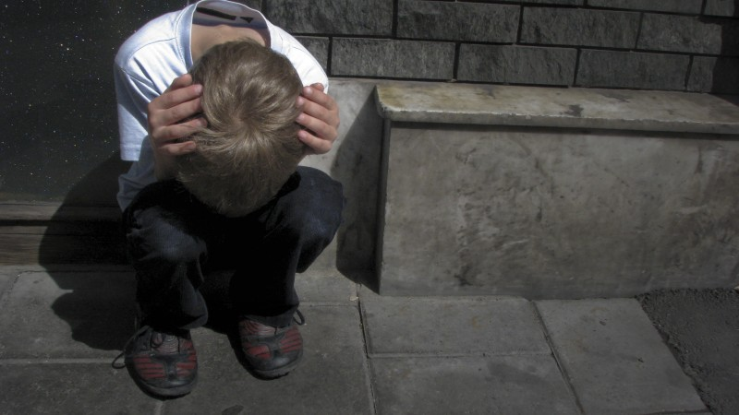
Types of Allegations (Maltreatments) of Abuse
Domestic Violence
Inadequate Supervision
Environmental Hazards
Physical Abuse
Sexual Abuse
Mental Injury
Failure To Thrive
Substance Misuse (Alcohol, Prescription Pills and Illicit drugs)
Medical Neglect
Asphyxiation
Family Violence
Failure to Protect
Human Trafficking
Substance Exposed Newborns
Bone/Skull Fractures
Internal Injury
Death
Abandonment

Slide 10
The Abuse Hotline then generates a case.
Notes:
The case is assigned to the appropriate region of Florida to Child Protective Investigations.

Slide 11
INVESTIGATIONS
Investigations can be under either the Department of Children and Families or a local Sherriff’s Office

Slide 12
DCF INVESTIGATIONS
Child Protective Investigator (CPI) is assigned a case for up to 60 days as they assess for child safety.
Child Protective Investigator Supervisor (CPIS) is the supervisor to the CPI who is accessible to all parties during the investigation.
CPI is investigating to determine child safety in terms of Present Danger and Impending Danger threats to the children.
Notes:
The CPI and law enforcement are the front line responders to the commencement of a case. They assess for child safety and overall family condition.
The CPI responds to the allegations/maltreatments of abuse or neglect to determine the safety of the child(ren).
If the child(ren) are determined to be unsafe, they may either be removed from the home or remain in the home with an in-home safety plan.
CPI’s can gather information from collateral sources familiar with the family functioning such as a teacher, neighbor, or family member.

Slide 13
Definition of Safe and Unsafe
SAFE…children are considered safe when there are no present or impending danger threats, or the caregivers’ protective capacities control existing threats.
For example, the mother is using drugs but the father controls for her use around children so they are unaffected.
Notes:
So let’s begin with definitions of these two key terms, safe and unsafe. First the definition of Safe…children are considered safe when there are no present or impending danger threats, or the caregivers’ protective capacities control existing threats.

Slide 14
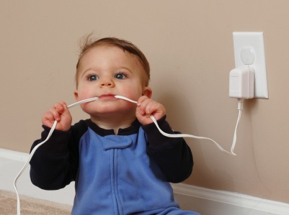
Definition of Safe and Unsafe
UNSAFE… children are vulnerable to present or impending danger threats, and caregivers have insufficient protective capacity to control existing threats.
Notes:
For example, both parents are currently using drugs around the children and children are not safe.

Slide 15
Safety Determinations
Present Danger
Impending Danger
Notes:
During the course of an investigation the Investigator is trying to determine if resent or Impending Danger threats are occurring.

Slide 16
Present Danger – What are the criteria?
The danger threat is happening now and requires immediate response from CPI…for example immediate removal from home.
Notes:
We will explore Present Danger first because it is the most obvious and always the first condition to address in any contact with a family.
Present danger is the immediate, significant and clearly observable severe harm or threat of severe harm that is occurring to a child at the present time, in other words, right now….and which requires an immediate child protection response.
It’s important to keep in mind that present danger can arise at any point in the life of a case, it is not limited to our first contact with the family and it is not limited to CPI intervention. At any point in time if the circumstances in the family present immediate, out of control and potentially severe threats to a child, happening in the present time, that is present danger and immediate action is required.
Example: The parent is currently observed to be under the influence while caring for the child and has tested positive for opiates on their drug screen. The parent does not have a prescription for opiates.

Slide 17
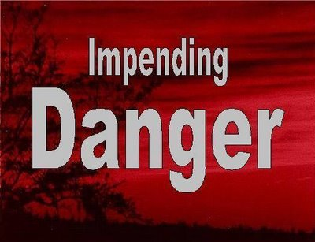
Impending Danger – What are the criteria?
Observable: Can be behaviorally described in detail
Out of Control: No responsible adult can prevent or stop threat
Imminent: - could or likely will occur in the near term
Vulnerability: A child is vulnerable to the threat
Severity: Threat will likely result in severe harm to a child
Notes:
Our second important concept after Present Danger, is Impending Danger.
Just as the word implies, this is danger that is not happening at this moment, but what we would more accurately describe as a “state of danger”. So this is descriptive of those circumstances in which the child is in a position of continual danger.
Impending danger threats are also imminent, which means they could or likely will occur in the near term (next few days). We are not making a specific estimate of when they will occur, but we are making a professional judgment that they will occur in the near future, and therefore, they require a controlling intervention.
Example 1: Parent continues to test positive for opiates and willing to develop an in-home safety Plan
Example 2: Parent continues to test positive for opiates and is unwilling to develop an in-home safety plan then DCF removes child

Slide 18
Safety Determination
FIVE In Home Safety Analysis Questions:
Is the parent willing/ able?
Is the home calm/ consistent?
Are there sufficient safety service providers available?
Is there sufficient information without professional evaluations needed?
Does the parent have a home to enact a safety plan?
If the answer to any of these questions is “NO” the child will be removed from home.

Slide 19
The Child Welfare Professional’s Tool: Family Functioning Assessment (FFA):
The FFA consists of 6 domains:
Extent of maltreatment
Surrounding circumstances
Child functioning
Adult Functioning
General Parenting practices
Disciplinary Practices/Behavioral Management
KNOW THE FAMILY
Extent of Maltreatment
Surrounding Circumstances
Child Functioning
Adult Functioning
Disciplinary Practices/Behavior Management
General Parenting Practices
Notes:
Similar to a biopsychosocial for behavioral health services. It informs the case and the safety determination once it has been completely answered. It is an ongoing document that is used by CPI and Dependency Case Managers.

Slide 20
The Purpose of the Family Functioning Assessment (FFA):
Fully describes what has or is happening in each domain, providing a clear picture and accurate understanding without having to refer to additional material.
Is essential to gaining a full understanding or complete picture each of the 6 domains.

Slide 21
The Purpose of the Family Functioning Assessment (FFA):
Adequately describes the role of other persons in the home or the family resource network.
Provides clear rationale for decision making and supports the identification of impending danger and diminished caregiver protective capacities.

Slide 22
Example of family Functioning Assessment (FFA)
http://centerforchildwelfare.fmhi.usf.edu/Preservice/CPISpecialtyTrack/CPI%20Sandler%20Documents/Sandler%20FFA-Investigation_v1_2014%203-15.pdf

Slide 23
Definition of Caregiver Protective Capacities
Caregiver Protective Capacities are personal qualities that are behavioral, cognitive, and emotional characteristics.
These characteristics can be specifically and directly associated with being protective of one’s young, which contribute to vigilant child protection.

Slide 24
When is a Parent or Caregiver Protective?

Slide 25
Protective Capacities
Vigilant Protectiveness
Cognitive
Behavioral
Emotional
Notes:
Protective capacities are cognitive, behavioral and emotional qualities supporting vigilant protectiveness.

Slide 26
Definition of Protective Capacity
Protective Capacity…how a parent thinks, feels, and acts…helps control the safety threat to the child.
Notes:
Protective capacity is a specific quality that can be observed and understood to be part of the way a parent thinks, feels and acts that makes him or her protective.
Protective capacities are different from strengths. Protective capacities are what the parent possesses to help control the threat. (Example: Strength might be extended family support; protective capacity might be the parent is able to verbalize the threat and possible harm to child)

Slide 27
Cognitive Protective Capacity
Examples:
Reality oriented
Accurate perception of a child
Recognition of a child’s need
Ability to accurately process and interpret various stimuli

Slide 28
Cognitive Protective Capacity
Examples:
Understanding of protective role
Intellectually able
Understanding and recognizing threats (i.e.…Inadequate Supervision, Violence, Substance Use, Mental Health Struggles)

Slide 29
Behavioral Protective Capacity
Examples:
Physical capacity and energy
Ability to set aside own needs
Adaptive, assertive and responsive
This Photo by Unknown Author is licensed under CC BY-SA-NC

Slide 30
Behavioral Protective Capacity
Examples:
Takes action
Impulse control
History of being protective

Slide 31
Emotional Protective Capacity
Examples:
Emotional bond with the child
Positive attachment with the child
Love, sensitivity and empathy for the child
Resiliency

Slide 32
Emotional Protective Capacity
Examples:
Stability
Effectively meets own emotional needs
Needs emotional control
Realizes the child cannot produce gratification and self-esteem for the parent

Slide 33
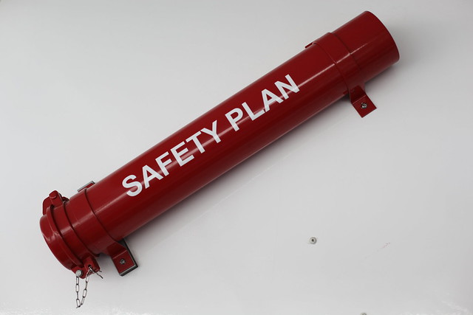
What is a Safety Plan?
Safety Plan: Actions and Services that will temporarily substitute for the diminished parental protective capacity to control the danger threats endangering the child.
Notes:
These actions and tasks are called a safety plan.
A safety plan is made up of the actions and services that will temporarily substitute for the diminished parental protective capacity to control the danger
threats.
A child must be deemed UNSAFE for safety plan to be developed.

Slide 34
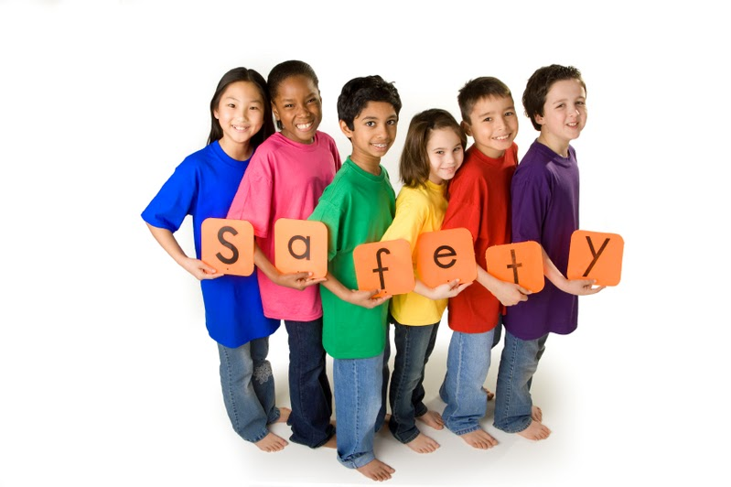
Safety Plans
An unsafe child does not automatically require placement outside the home:
Safety plans range from entirely in-home to exclusively out-of-home care.
Notes:
A safety plan’s objective is to control threats in the least intrusive manner.
Example of In-Home: CPI gets a family member move in to the household to supervise parents while with children.
Example of Out-of-Home: CPI places child at a family members house or a neighbor.

Slide 35
Child Safety Planning
All children who are assessed to be UNSAFE WILL receive a safety plan and WILL be referred to Dependency Case Management.
Families who are assessed to be SAFE will NOT receive a safety plan and/or case management but can be assessed for community services needs and referrals such as therapy, targeted case management, and parenting just to name a few.

Slide 36
Implications of DCF Safety plan for Behavioral Health
The Safety Plan is created to help keep children safe and should be shared with Behavioral Health providers having contact with the family.
Behavioral Health Providers can use the Safety Plan to help inform treatment planning with parents to assist with behavioral change.
Notes:
Safety Plans are meant to be used as living documents to amend as needed if new information arises from collateral sources.
The more intense the level of collaboration between parties, the more likely the plan can be maintained.

Slide 37
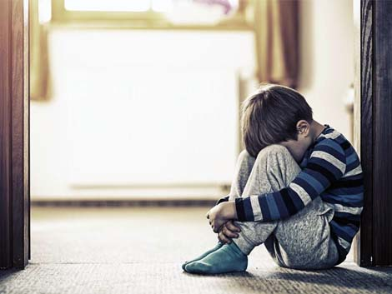
The Unsafe Child
If a child cannot remain safely in the home the CPI removes the child and files a shelter petition with the court. If granted by a judge, the child is then “sheltered” from the offending caregiver(s).
Notes:
The child can be placed with a relative/non-relative and if this is not possible the child is placed into licensed care.
The case is then transferred to Case Management services from Investigations

Slide 38
From Investigations to Case Management

Slide 39
DEPENDENCY CASE MANAGEMENT
ChildNet (C15 and C17) and Communities Connected for Kids (C19) are Dependency Case Management Services Providers.

Slide 40
DEPENDENCY CASE MANAGEMENT
Dependency Case Manager (DCM): provides ongoing support and supervision to family.
Dependency Case Manager Supervisor (DCMS) is the supervisor of the DCM.
Notes:
Once the family is moved from investigations to dependency case management they are assigned a case manager (DCM) who provides continual support and supervision.

Slide 41
The Role of Dependency Case Management (DCM)
Monitor the Case Plan
Assessing how the family is functioning
Correctly identifying what in the family system needs to change
Determining when behavior change has occurred
Recognizing immediate and ongoing safety needs.

Slide 42
Notes:
The case planning process is a collaboration between the parents, Children 14 or older, family members, CPI/DCM, Guardian Ad Litem (GAL), and various proders

Slide 43
Case Planning
Case planning is the act of establishing outcomes and motivation for change with families.
It helps families develop a goal to exit the child welfare system by helping them build on fortifying their diminished caregiver capacities.

Slide 44
What a Case Plan Must Include
Description of the parents’ tasks and services which specifically address the identified problem(s):
Services/treatment types
Date each service/referral will be provided
Date parent must complete each task
Services/treatment frequency
Service delivery location
Accountable agency/provider staff
Resources including those that are social determinants to health e.g. housing

Slide 45
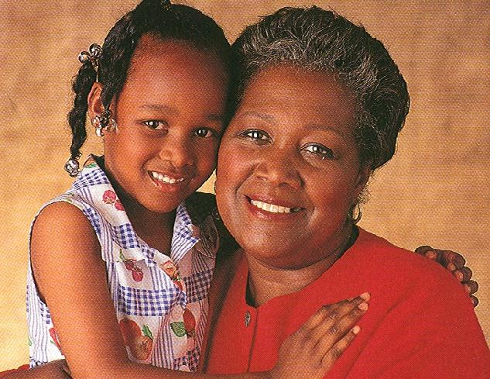
The Common Objective: Permanency
Notes:
11.4.33

Slide 46
What are Permanency Goals: Potential Outcomes For Families
Reunification with Parents/Guardians
Adoption
Permanent guardianship of a dependent child
Permanent placement with a fit and willing relative
Placement in another planned permanent living arrangement

Slide 47
Implications For Service Providers
Service Providers should be aware of the Caregiver Protective Capacities that have been identified as being diminished so they can address those struggles with family throughout treatment or service.
Treatment Plans and subsequent services should address Diminished Caregiver Protective Capacities which enables Behavioral Health and Child Welfare to collaboratively work together to support a family’s needs.
Notes:
CPIs will be looking for the Progress Exchange Form to begin informing referral needs of the family and ongoing progress in treatment/service.
Case Managers will be looking for monthly Progress Exchange Forms that address behavioral change and awareness on the part of the parent and not just compliance. Providers should upload the Progress Exchange Forms monthly into FSFN for ongoing collaboration.
Behavioral Health should know allegations, review FFA, collaborate with CPI/DCM, and participate in joint staffing’s to promote reaching long term goals for our families.

