Slide 1


Network Provider Meeting
December 2, 2020

Slide 2
Provider Meeting Agenda
Welcome and Introductions – Becky Walker
Changes to Validation/Monitoring Process
  Ownership and Accountability – Ann Berner
  Changes and Process – Angie Vyas-Knight
  Telehealth Quality Assurance Validation Tool – Lindsay Slattery-Cerny
Provider E-Contracting System 2 Implementation – Daniel Oria
Electronic Invoice Application – Becky Walker
Vouchers – Linda Kane and Greg Jackson
Consumer Satisfaction Surveys – Daniel Oria
MyStrength – Mayra Martinez-Gelabert
Proposals for SOR 2 Funding – Linda Kane
Telephone Number changes at SEFBHN
Personal Protective Equipment - Becky Walker
House Bill 945 Coordinated System of Care – Jill Sorensen
FASAMS Update- Discharge Reasons – Diego and Sharyn

Slide 3
Ownership and Accountability

Slide 4

Tiered Validation Process
Virtual Provider Meeting
December 2, 2020

Slide 5
Validations ensure contracted services are delivered as expected.
So… what is the contract?
Master Contract
Guidance Documents
CORE Handbook
SEFBHN 3 Page Contract
Service Delivery Narrative
BASE Handbook
All of this and any additional incorporated documents.
The Memorandum of Negotiation is also an important resource.
Statement of Funding

Slide 6
Policy, Procedure, and Tools for General Contract Monitoring
Fiscal Stability
Records
Performance Improvement Plan Review
Audits
Accounting System
Insurance
Sponsorship
Publicity

Slide 7
Policy, Procedure, and Tools for General Contract Monitoring
Lobbying
Client Risk and Incident Reporting
Intellectual Property Rights
Data Security
Confidentiality of Client Information
Assignments and Subcontracts
Grievance Procedure

Slide 8
Policy, Procedure, and Tools for Program Monitoring
Scope of Service
Service Tasks
Staffing Requirements
Deliverables
Data Validation
Performance Specifications
Network Service Provider Responsibilities
Method of Payment
Fidelity to Evidence-Informed Level of Service Need Determinations and Subsequent Service Placement

Slide 9
Policy, Procedure, and Tools for Background Screening Monitoring
Level 1 and 2 Screening
Screening Exemptions or Exclusions
Attestations

Slide 10
Validation Flow
What do I need to do for Tier 1?
Who needs a Tier 2 Validation?
Is everybody getting Tier 3 validations?

Slide 11
Validation Flow
Tier 1 is completed internally at Southeast Florida Behavioral Health Network, Inc.
This takes no additional effort on the Provider’s side as this is an assessment of the agency’s risk based on prior behavior and future funding/service array.
In lieu of a traditional validation report, results are captured in the specific Risk Assessment Desk Review template and these results are then shared directly with the Provider.
Tier 1

Slide 12
Validation Flow
Following the completion of a Tier 1 validation, if additional review is needed or, if there is a known need for a Tier 3 validation (DCF frequency or new provider), a Tier 2 validation is scheduled.
The Scope for a Tier 2 Validation is customized per each Provider contract.
The length of time the Provider will have to gather documents will adjust based on the volume of documentation requested.
After a Tier 2 validation is completed, if no Tier 3 Validation is needed, a report is sent to agency within 30 days.
Tier 2

Slide 13
Validation Flow
If a Tier 3 validation is needed, any opportunities for improvement identified as part of the Tier 2 validation will be shared with the Provider prior to the Tier 3 validation.
The Scope for a Tier 3 Validation is customized per each Provider contract.
Official notification of the Tier 3 validation will be sent out two weeks prior to the date of the scheduled on-site validation.
Following completion of the Tier 3 validation, a report which contains observations from both the Tiers 2 and 3 validations will be sent to the Provider within 30 days.
Tier 3

Slide 14
Risk Assessment Desk Review
Tier 1

Slide 15
Major Elements: Quantitative Review
Current funding
Prior FY surplus or deficit
Compliance with prior Performance Improvement Plans
Dun and Bradstreet Financial Stress and Viability Scores *
Data quality *
Number of valid community complaints
Percent of Reports received timely
Distribution of low, medium, and high risk services.

Slide 16
Quantitative Review: Dun and Bradstreet
Financial Stress Score
  predicts the likelihood of a business experiencing financial stress in the next 12 months.
Viability Score
  assesses the probability that a company will no longer be in business within the next 12 months, compared to all U.S. businesses within the D&B database.
Portfolio Comparison
  compares a company to similar businesses within a D&B “model segment” classification
Data Depth Indicator
  represents the level of predictive data available for a company.

Slide 17
Quantitative Review: Data Quality
Score Card
  Reasonableness of Discharges
  Missing Records
  Covered Service Utilization
Data Quality Analysis
  Reasonableness of observations for each category
Non-Client Specific services
  Indication of need for additional review.

Slide 18
Major Elements: Qualitative Review
Accreditation status *
Funding categories
Populations served
Denial of service or person served rights grievances
Management letter on audit
Appropriate, active staff in IRAS
Late reported or unexpectedly low number of incidents
Feedback from other stakeholders
Agency stability: new leadership, newly established agency
Period of time since last validation

Slide 19
Qualitative Review: Accreditation Status
DCF dictates frequency of validation based on accreditation status
  Accredited: Every three years
  Not Accredited, no residential or inpatient (including CSU) services: Every two years
  Not Accredited, residential or inpatient (including CSU) services: Every year
Review of Material Weaknesses

Slide 20
Tiers 2 and 3
Biggest Change: Focus is shifting to validation of policies and procedures instead of service delivery process and documentation.

Slide 21
Tiers 2 and 3: Similar Scope Options
Attestations and Administrative Review
Block Grant
Prevention Program
Quality Assurance/Quality Improvement Work Products
Recovery Oriented System of Care (ROSC)
Performance Outcome Measures
Program-Specific Deliverables

Slide 22
Tiers 2 and 3: Differences
Tier 2
  Primarily (not exclusively) done through Desk Review
  Will follow-up on areas of concern identified in Tier 1 (Risk Assessment Desk Review)
  A report will not be generated at the completion of a Tier 2 if it is determined a Tier 3 validation will be required.
Tier 3
  Typically done on-site
    As a result of Coronavirus, a virtual visit may be used similar to the major accrediting bodies to maintain safety
  Includes Interviews
  Will follow-up on areas of concern identified in Tier 2.
  On-Site visits can be due to DCF frequency requirements and technical assistance to new agencies – not just high risk.

Slide 23
Scope: Attestations and Administrative Review
Employee Screening and Training
Incident Reporting
Satisfaction Surveys
Financial Eligibility
Required Reports
Rights or Denial of Services Grievances
Service/Invoice Validation
Validates adherence to administrative policies, ensures employment qualifications per DCF are met, and quality service delivery is taking place

Slide 24
Scope: Block Grant
Community Mental Health Services Block Grant
Substance Abuse Prevention and Treatment Block Grant
Substance Abuse Temporary Assistance for Needy Families (TANF)
Mental Health Temporary Assistance for Needy Families (TANF)
Substance Abuse HIV Programs
Validates adhere to policies and guidance surrounding block grant programs

Slide 25
Scope: Quality Assurance/Quality Improvement Work Products
Strategic Planning and Priorities
Family and Natural Supports
Wraparound
Non-Clinical Staff and Staff Wellbeing
Integration of Behavioral Health and Primary Care
Waitlist
Fidelity Review
Validates activities described in the Service Delivery Narrative.

Slide 26
Scope: Quality Assurance/Quality Improvement Work Products
Certified Peer Recovery Services
Trauma-Informed Care
Medication-Assisted Treatment
Level of Care Assessment
Quality Assurance
Care Coordination
Validates activities described in the Service Delivery Narrative.

Slide 27
Recovery Oriented System of Care (ROSC)
Meeting Basic Needs and Life Goals
Medication Assisted Treatment and Diversity of Treatment Options
Self Determination and Inviting Factor
Staff Interviews
Comprehensive Services and Involvement
Validates the agency’s efforts to ensure a ROSC-focused culture

Slide 28
Recovery Oriented System of Care (ROSC)
Strengths Based Approach
Customization, Choice, and Individually Tailored Services
Network Supports, Community Integration, and Recovery Focus
Supplemental Security Income/Social Security Disability Insurance (SSI/SSDI) Outreach, Access, and Recovery (SOAR) Applications
Validates the agency’s efforts to ensure a ROSC-focused culture

Slide 29
Scope: Other Areas
Prevention Programs: A review of the prevention services in a contract to ensure compliance with prevention and block grant requirements
Performance Outcome Measure Validation: Review of service appropriate performance outcome measure data and related documentation.
Program-Specific Deliverables: A review of program-specific deliverables and their related documentation may occur.
Validates the quality of performance Outcome Measures

Slide 30
Questions Always Welcomed
(Socially Distanced)

Slide 31


The Telehealth Quality Assurance Validation Tool
Lindsay Slattery-Cerny
Southeast Florida Behavioral Health Network

Slide 32
History of the Telehealth Quality Assurance Monitoring Tool
Internal workgroup convened at Southeast Florida Behavioral Health Network to evaluate best practices guidelines from agencies
Best practice guidelines were presented at the Continuous Quality Improvement (CQI) meeting on September 25, 2020, and feedback asked from the Provider Network.
Feedback from the Provider indicated that:
  Many providers indicated working with existing “face-to-face” service policies.
  Providers expressed a desire for more information and assistance for telehealth guidelines and support.
This feedback, along with the best practices identified earlier, assisted with the development of the Telehealth Quality Assurance Validation Tool.
Notes:
Lindsay

Slide 33




The Telehealth Quality Assurance Validation Tool
Areas of Monitoring (best practices and feedback):
Clinical Considerations
Safety & Crisis Recommendations
Monitoring and Technical Assistance (TA)
Technology and Access to Services
Supervisory Practices
Legal and Ethical Considerations
Policies and Procedures

Slide 34
Monitoring Telehealth Practices, Procedures and Policies
This Telehealth Quality Assurance Validation Tool is currently under development to address previously mentioned areas. Some additional items are:
  Retention in treatment, along with basic outcomes per department.
  Consistency and frequency of services.
  Rapport building and techniques to keep individuals engaged via telehealth.
  Service delivery – treatment planning, discharge planning, etc.
Also, an item of importance is using the Telehealth modifier (GT) to designate that a service was provided through the use of telemedicine.

Slide 35
Required Reports
Submitting Reports is Going to Get Easier!
Notes:
Today, we’re going to talk about Required Reports, which, on it’s own is probably not very exciting, but it is extremely important. Today we’re making a major change to how you submit required reports to us and it is kind of exciting because it is going to make things much easier for you and us. And, obviously, this is something that affects practically every provider here so hopefully the change we’re making is going to save you time and effort.

Slide 36
What required reports are we talking about?
The current system where you submit reports
The new system
Notes:
So, first I’m going to detail which required reports we’re talking about exactly, just to make sure we’re on the same page. I’m going to briefly discuss the current system and some of the reasons that we’re making this change. And then I’ll focus the majority of the time going over the new system and how it works.

Slide 37
What Required Reports?
Monthly Auxiliary Aids Reports
National Voter Registration Act Reports (quarterly)
Cost reimbursement/reconciliation reports
Excel Invoices (not electronic invoice system)
Liability insurance, licenses, service delivery narratives, accreditation reports, etc.
And much much more…
Notes:
There are many reports that all pretty much all providers have to submit, and there are some reports that are unique to particular funding source, program, or provider.

Slide 38
Accreditation Report
AHCA Licenses
Auto Insurance Certificate
Auxiliary Aid Service Record
Auxiliary Aids and Services Plan
BASE Update
Block Grant Prevention Report
BNET Alt Services Documentation
BNET Alt Services Documentation (Pharmaceuticals)
BNET Statement of Program Cost
Budget Narrative
Budget Proposal
Care Coordination Report
CAT Team Monthly Data Reporting Template
CAT Team Numbers Served and Performance Report
CAT Team Quarterly Reconciliation Report
CAT Team Quarterly Supplemental Data Report
Civil Rights Compliance Checklist
Closeout Inventory
CMHSOC IPP Survey
CMHSOC Reporting Template
Consumer Satisfaction Surveys
Contact Info for Key Personnel
Cost Reimbursement Reconciliation
CVRR
DCF Licenses
Drop-In Center Numbers Served Report
Emergency Preparedness Plan
Executed Agreement
Executed Amendment
Executed Contract
FACT Advisory Meeting Minutes
FACT Census
FACT Enhancement Reconciliation Report
FACT Monthly Referral Report
FACT Quarterly Report
FACT Staffing Standards Report
Federally Qualified Health Center MOU
Final Invoice
Final Invoice Supporting Documentation
Financial and Compliance Audit
FITT Services Monthly List of Families Served
FITT Services Monthly Progress Report
Forensic and Civil Discharge Report
Forensic Competency Restoration Report
Forensic Conditional Release and State Hospitals List
Forensic Conditional Release Report
Forensic Diversion Report
Forensic Quarterly Visit Reports
Invoice
Invoice Supporting Documentation
IV Drug Users Service Capacity Report
Letter for Signature Authority
Liability Insurance Cert (DCF addl insd)
Liability Insurance Cert (SEFBHN addl insd)
List of Board of Directors and Contact Info
Local Match Calculation Form and Annual Match Plan
Memorandum of Negotiation
National Voter Registration Act Data
New Provider Application
Notice
Organizational Chart
Other Contract Document
Other Report
Other Stakeholder Report
PATH Intended Use Plan
PATH Quarterly Performance Report
Peer Services Monthly Progress Report
Peer Services Monthly Reconciliation
PFS DENs Meeting Report
PFS DENs Quarterly Report
PFS School-Based Report
Proof of Non-Profit Status
Property Inventory List
Return on Investment Report
SA Community Prevention CCAP
SA Community Prevention Evaluation Plan
SA Community Prevention Logic Model
SA Community Prevention Needs Assessment
Schedule of Actual Expenses and Revenues
Schedule of Bed-Day Availability Payments
Schedule of Related Party Transaction Adjustments
Schedule of State Earnings
Service Delivery Narrative
Sliding Fee Scale
SOR Hospital Bridge Report
SOR Jail Bridge Report
SOR Prevention Report
Statement of Funding
Statement of Funding Update
Validation Monitoring Plan
Women's Special Funding Report
Wraparound Certification Tracking Log
Wraparound Monthly Outcome Report
Wraparound Satisfaction Surveys
Notes:
There are many many different kinds of reports! Don’t worry if you didn’t get all that, there is a list!

Slide 39
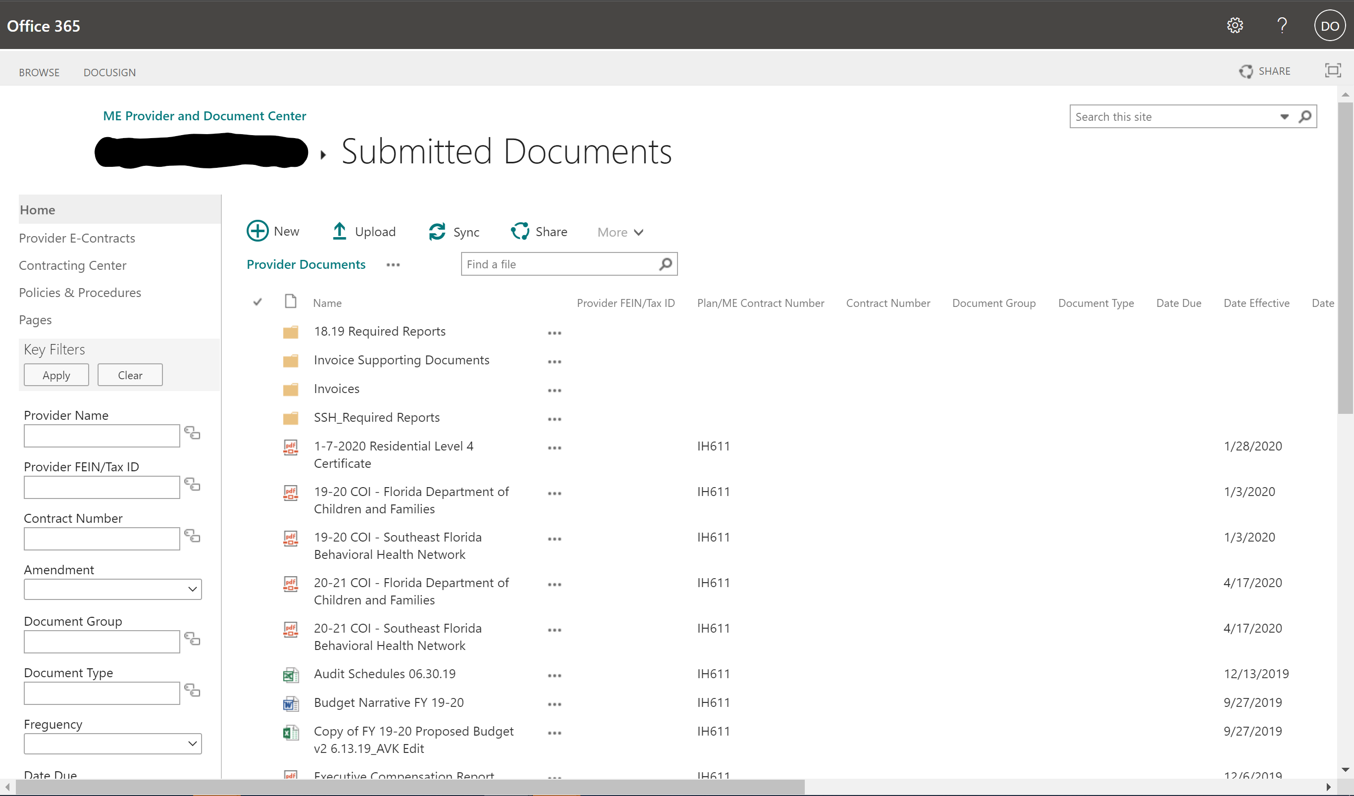
Notes:
Currently the System we have looks a little bit like this. It may look slightly different for you, but it is basically a Sharepoint site that was made some time ago. We call this the Provider E-Contracting System.

Slide 40
Provider E-Contracting System (PECS)
Microsoft 365 Sharepoint
Microsoft 365 Portal
“That thing we submit stuff to.”
Notes:
It has also been called the Microsoft 365 Sharepoint, Microsoft 365 portal and other names as well!

Slide 41
Old PECS
Notes:
I’ll just be calling it Old PECS right now.

Slide 42
Old PECS
The system has had some issues:
  Special access/login required
  Required file naming convention
  Lack of consistency in file locations
  Lack of notifications when uploads occur
  Data inconsistency
Notes:
Old PECS had some significant drawbacks for everyone involved that motivated us to replace it.

Slide 43
The New System
No required naming convention for files
Accessible directly from the New Carisk Portal
Primary Points of Contact know when you’ve submitted something
Easy and fast submission form
Due dates and timeliness will be tracked
Notes:
The new system we’ve created addresses practically all of those drawbacks. Internally, we’re calling it PECS 2, but the name really doesn’t matter much because it will be integrated into the New Portal as just another form you will use on there.

Slide 44
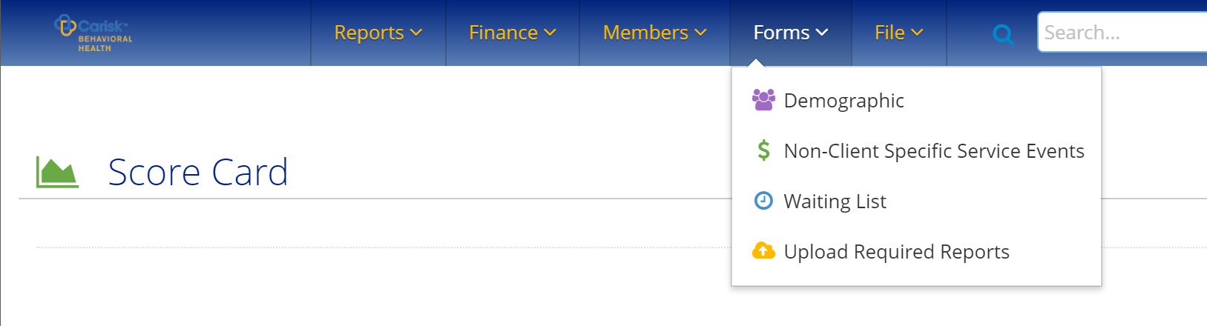
Notes:
You’ll be able to access the new system directly from the New Carisk Portal by clicking on “Forms” and “Upload Required Reports.” It’s very easy and you and anyone with a login to the New Carisk Portal will be to access it with your existing login with no changes whatsoever.

Slide 45
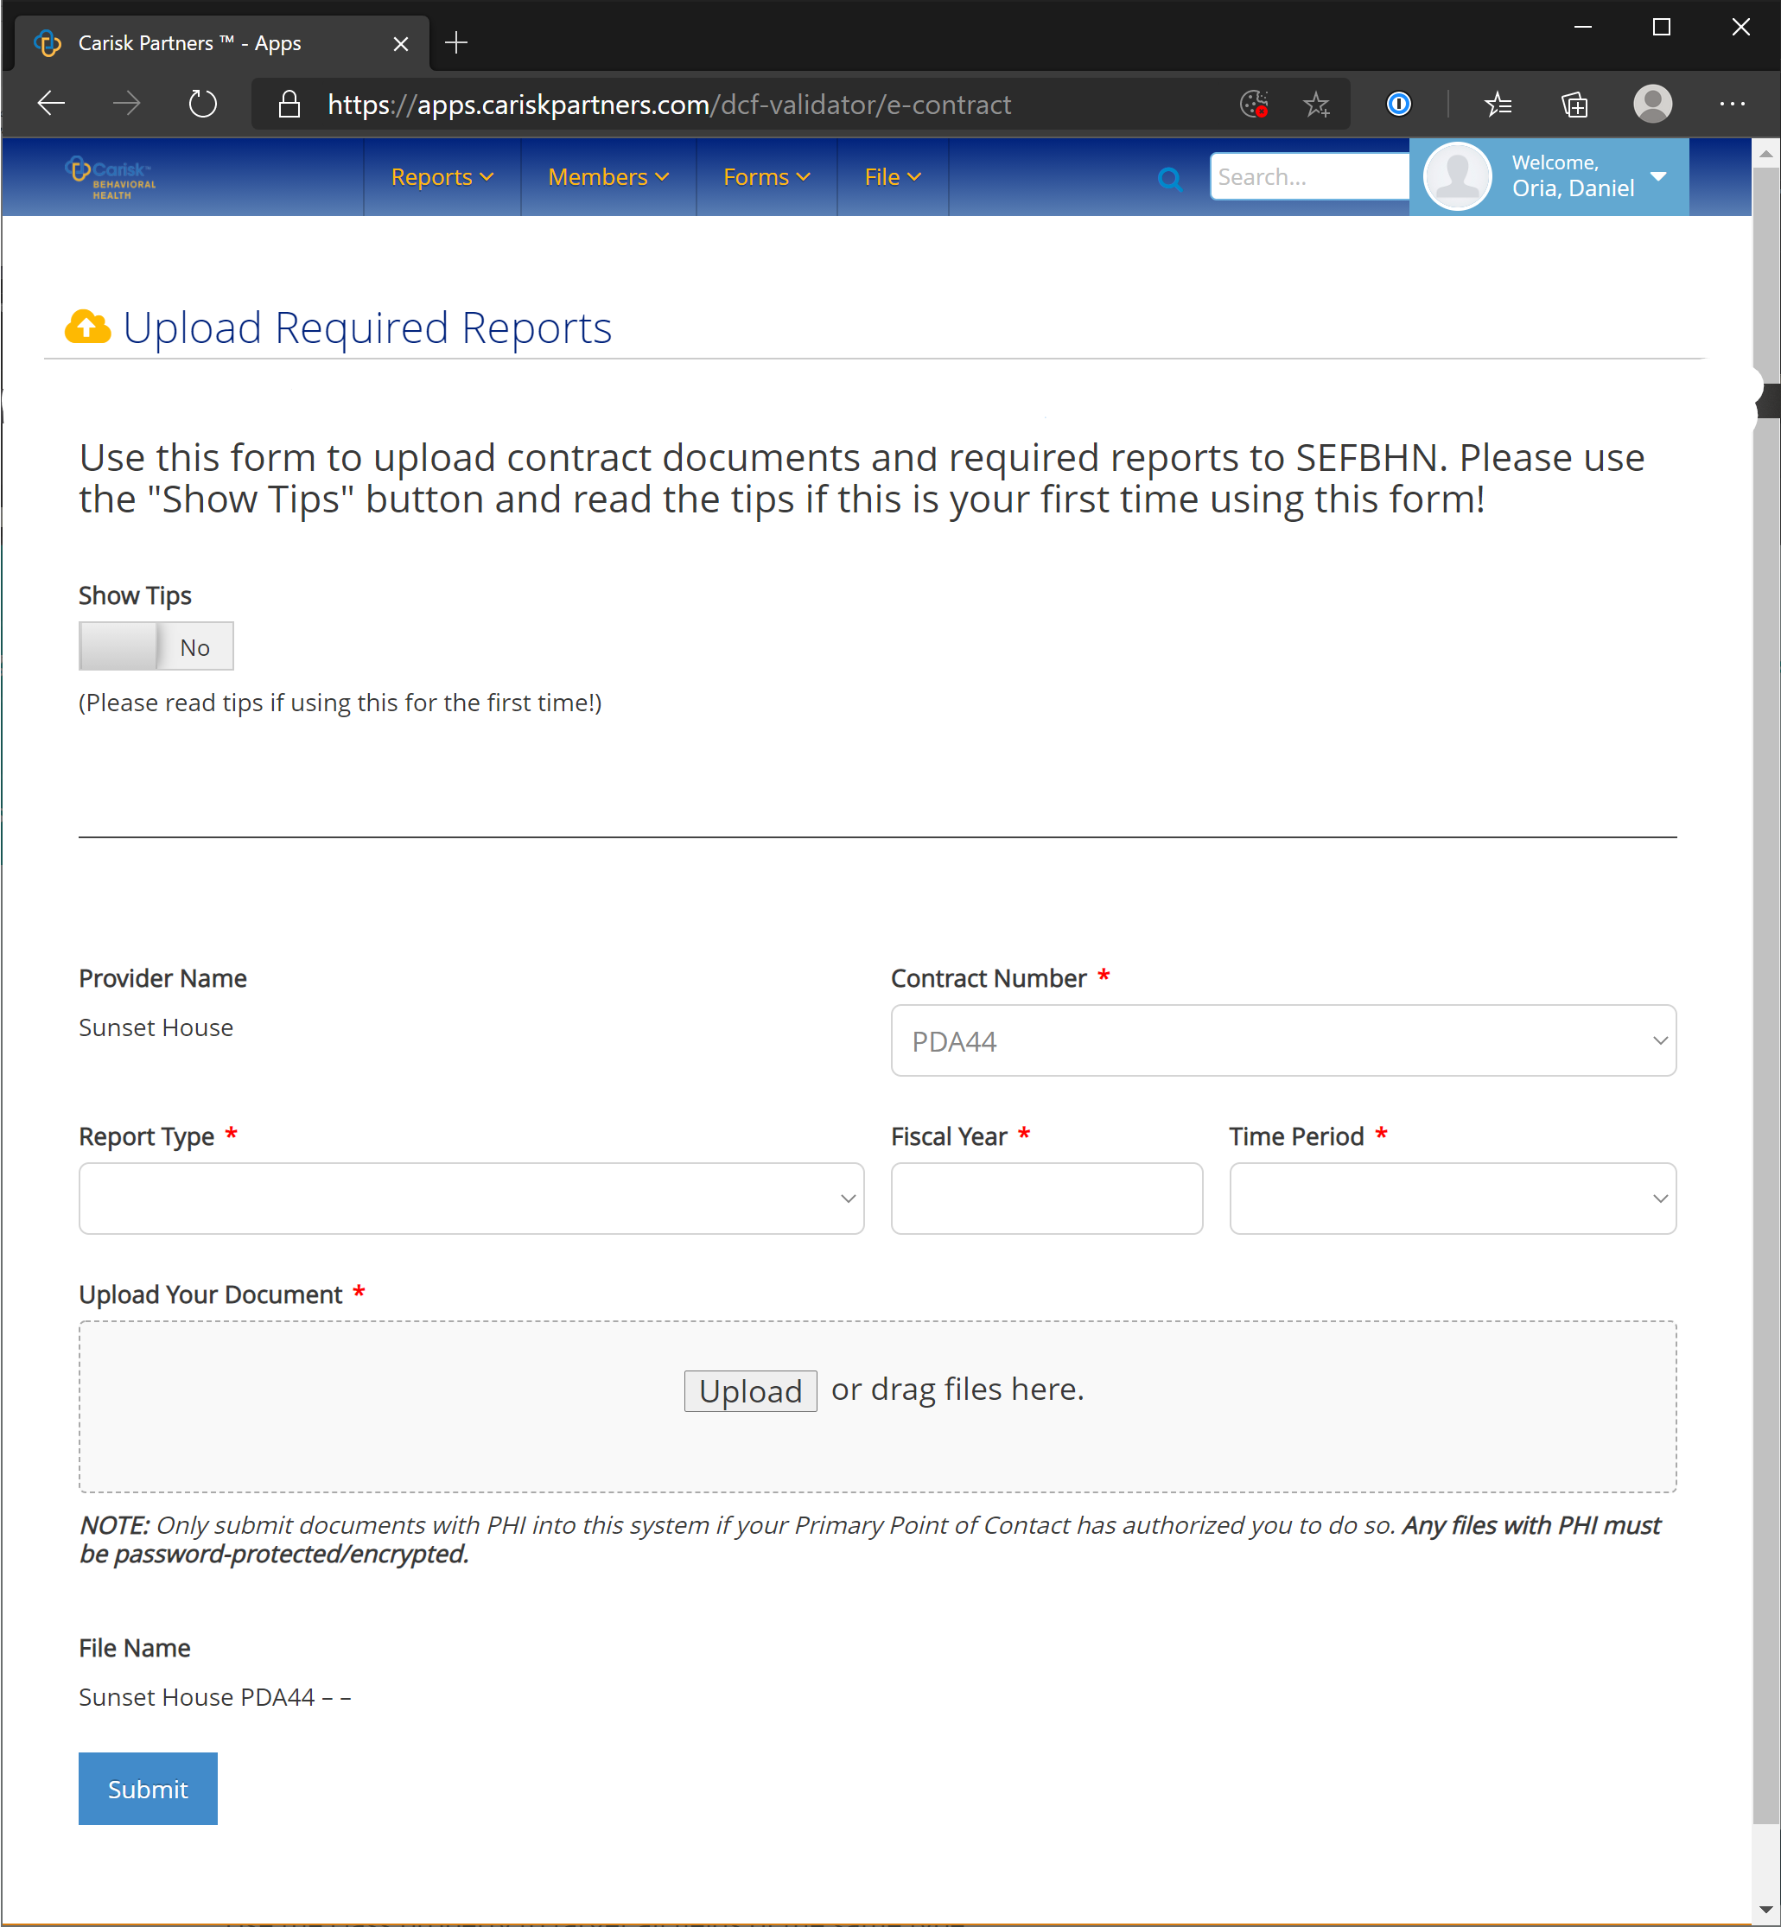
Notes:
This is what the new system looks like more or less. The styling of the drop downs and text will be different in the New Portal, but this is what the functionality is.

Slide 46
Notes:
Although there are some other elements, what you will be concerned with is really just these few dropdowns here and the Upload section. So, it’s actually very simple. I’ll show you how it’s going to work.

Slide 47
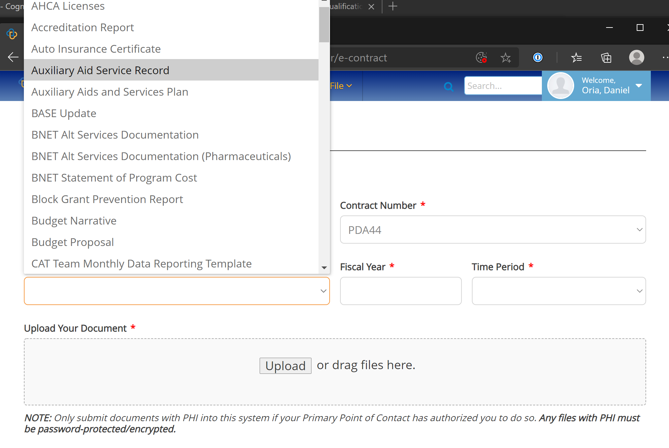
Notes:
First you choose what report you’re uploading. As I mentioned before, there’s a long list here, but most of the time you’re going to be using a certain set of reports that you frequently upload. In this case, I’ll show you what it will be like to upload an auxiliary aids service record since that’s a common one.

Slide 48
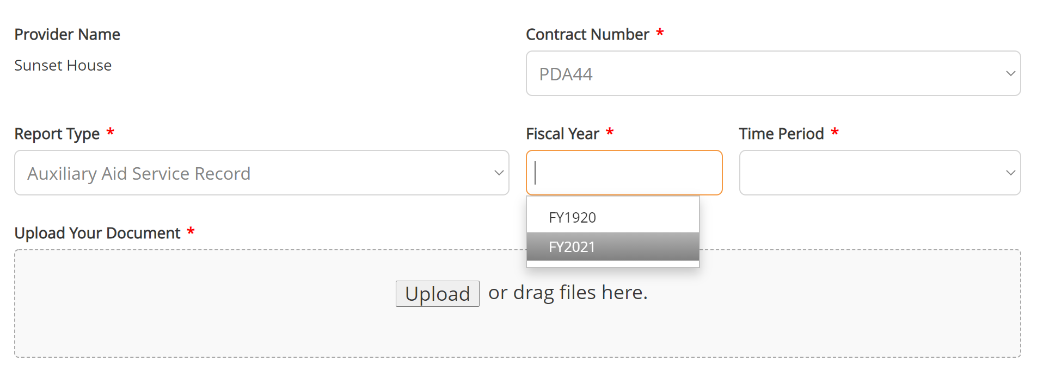
Notes:
Once you select that, you chose a fiscal year, whatever fiscal year the report actually applies to. Most of the time you’re going to be selecting FY2021 right now. If you’re uploading a document that applies to next fiscal year, like a Service Delivery Narrative your submitting, you’ll choose FY2122. That option will come up here once that’s actually relevant, probably around February or March of next year.

Slide 49
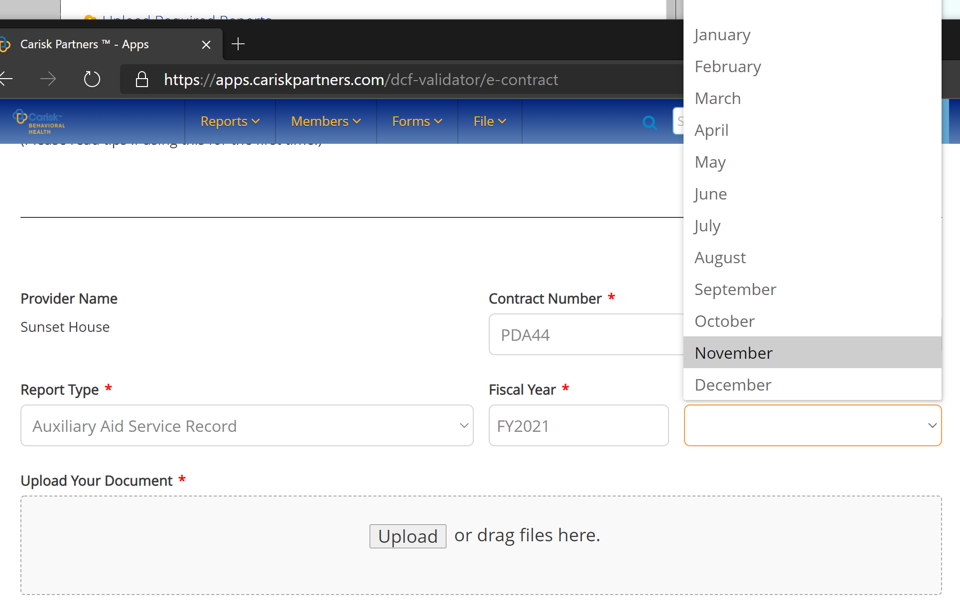
Notes:
The system knows that this report is submitted monthly, so it gives you options for months to indicate what time period this report applies to specifically. In this case we’re submitting the report for November.

Slide 50
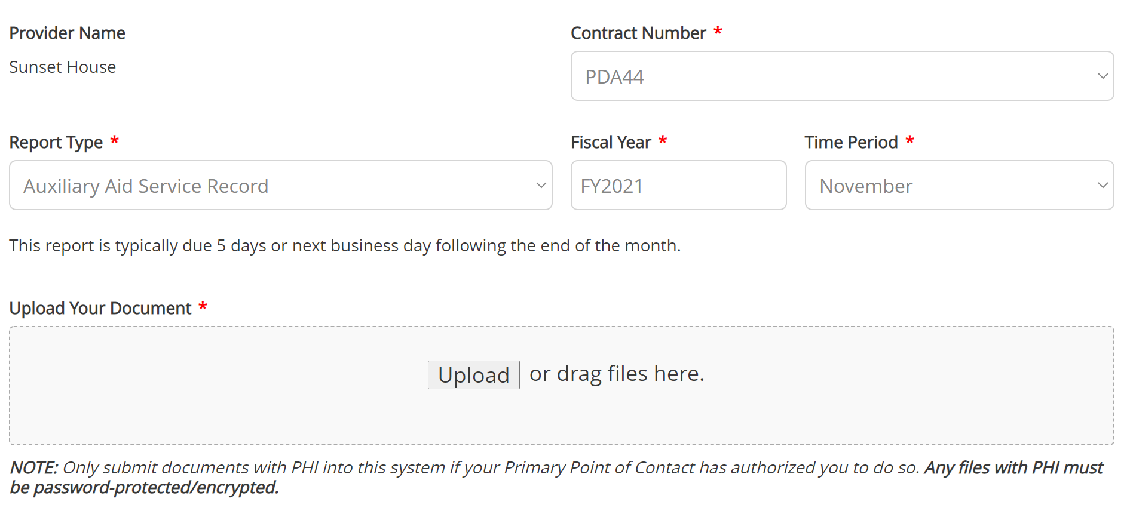
Notes:
Once you’ve done that the system tells you when that report is usually due, so you can make a decision about whether you should panic or not if you’re submitting this late! And now we just select the file we need to upload by clicking “Upload” or dragging a file into the grey area. Now, as you can see there’s a key not about PHI. Also, I want to stress that it does not matter AT ALL what you’ve named your file that you’re uploading.

Slide 51
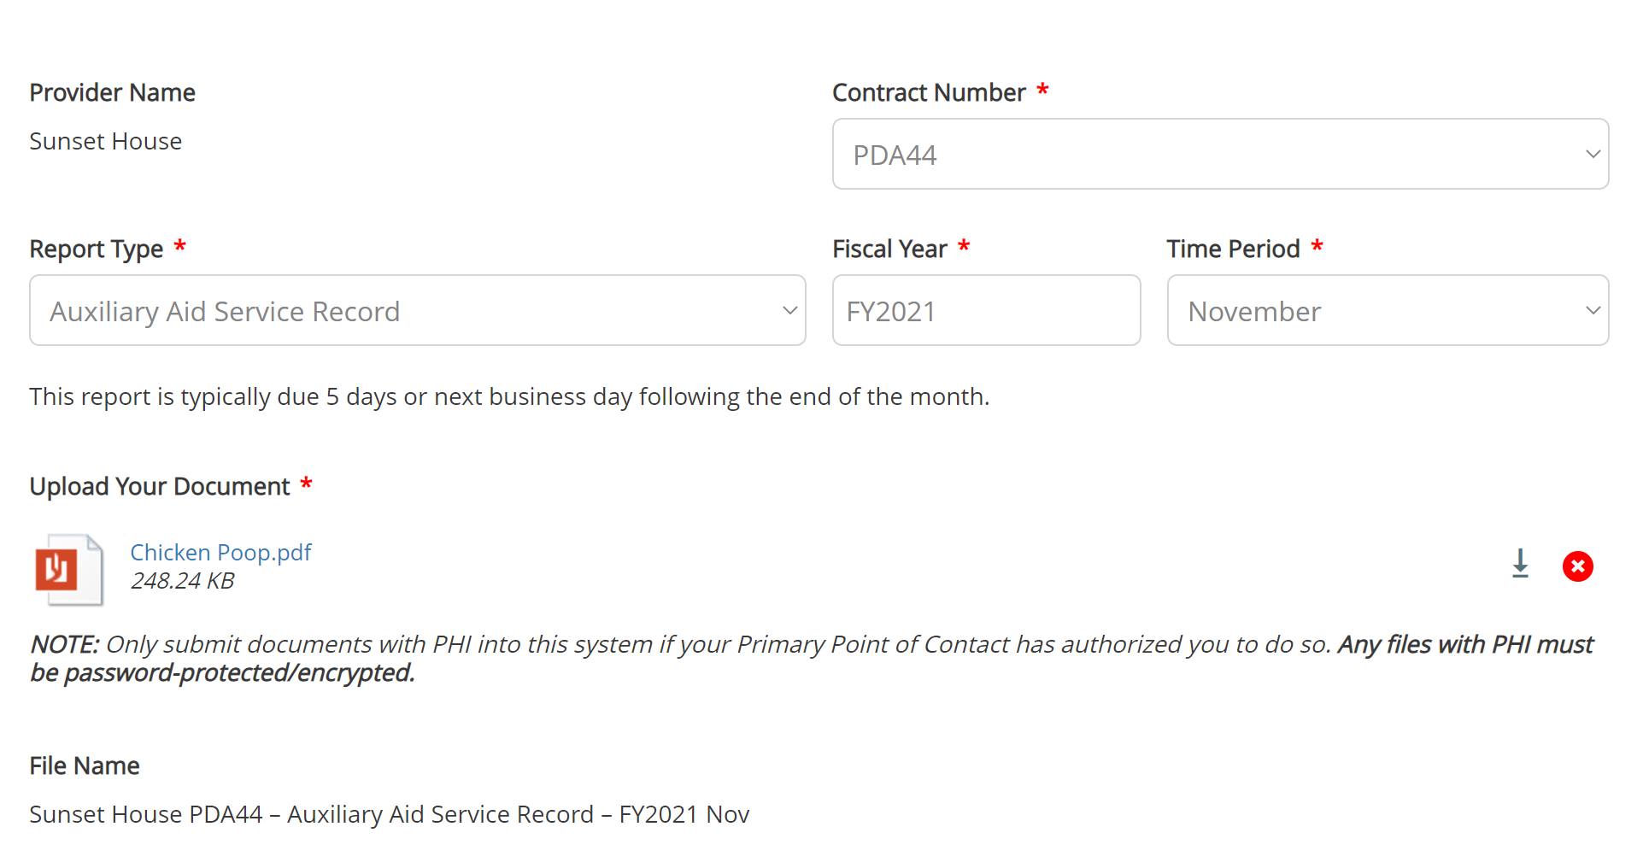
Notes:
In fact, in this case, I’ve named this file “Chicken Poop” because it really doesn’t matter. Your file will automatically be given a proper name on our end once it gets submitted, and the system shows you what that looks like.

Slide 52
After You Submit
You (the submitter) will receive an email confirmation with what you submitted for your records.
Your Primary Point of Contact (PPOC) will be notified and will review your submission.
  If there’s an issue, they will email you, otherwise you’re good!

Slide 53
Demo
Notes:
Now we’re going to Demo this!

Slide 54
Required Reports Made Easier
Starting today (12/2/20) the new “Upload Required Reports” form in the New Carisk Portal fully replaces Old PECS.
Anything you’ve uploaded/submitted to date does not have to be resubmitted to us (unless we can’t find it or find an issue).
If you have been submitting a required report via any other means (e.g. email), contact your Primary Point of Contact for guidance.
If you have questions about what you should be submitting or what report type to choose, etc. contact your Primary Point of Contact.
If you find a bug/technical issue reach out to Daniel.Oria@sefbhn.org.

Slide 55
Questions?
Notes:
Now we’re going to Demo this!

Slide 56
One more thing…
DCF will be resuming collection of consumer satisfaction surveys as soon as possible.
Requirements for # of surveys will not be tracked for Q1 and Q2.
Please do not use the existing FY1920 links you have previously been given, we will be sending out new unique links for FY2021 to you for your agencies by Friday, December 11.
Consumer Satisfaction Surveys will be collected electronically only for FY2021.
  Case-by-base exceptions may be made.

Slide 57
Electronic Invoice Application
Must have previous months completed
Must match excel invoice
Going to only electronic invoice soon
MAKE SURE INVOICE IS FORWARDED FOR REVIEW

Slide 58
Transitional Vouchers
257 voucher requests submitted since July 1, 2020
  209 have been approved,
  only 9 were denied (or canceled prior to approval)
  39 pending approval or further information
 | Total | Assisted Living Facility | Independent Housing | Licensed (DCF, AHCA, other Professional) | FARR Certification
MHTRV | 111 | 18 | 68 | 22 | 0
MSTRV | 98 | 0 | 9 | 0 | 89

Slide 59
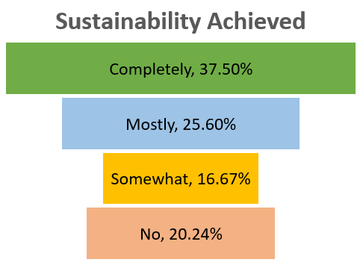

Slide 61


for Behavioral Health
by
®
Annual Engagement Overview
December 2, 2020

Slide 62
2020 Executive Summary
2020 Goals | Success Status
Target 50 consumer registrations per month | 93% of the annual goal as of 10/31/20
Engage 100% of Provider Network to launch with members | Launched 62% of SEFBHN Providers offering myStrength 17 Leadership Kick-off’s & Provider Trainings combined
Engage 100% of Provider Network to launch as a Staff Wellness resource | 100% Staff Wellness launched Marketing collateral & access codes created for each SEFBHN provider
Identify 2 Clinical Champion organizations | Exceeded goal with 3 provider champions Drug Abuse Treatment Association Community Partners of South Florida Jeff Industries
Outcomes:
36% report improvement with Clinical Depression
    38% report clinical improvement with Clinical Anxiety
    8.6 Average Logins for Returning Members
    95% Positive Ratings from Members
“Thank you so much!!!! I love this app and am certain I will be using it often with my clients! I needed some new information to use and keep my clinical work fresh” - Jodie Edwards- DATA-School Based Behavioral Health Counselor

Slide 63

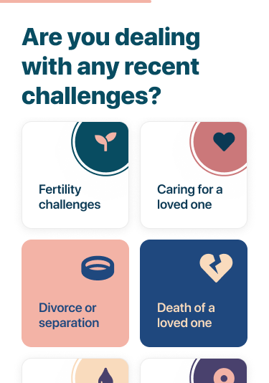
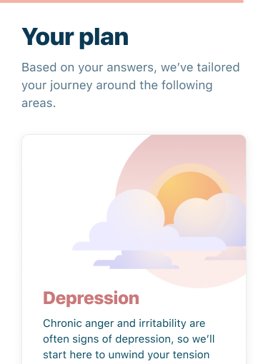
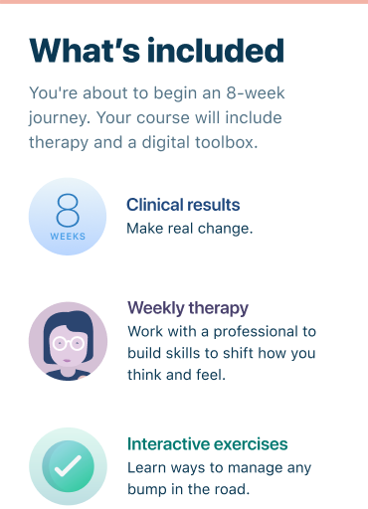
More Powerful Personalization Drives
Greater Engagement
1
2
3
Clinically-based dynamic assessment¹ determines condition and acuity
Curated individualized care journey² suggests right mix of services and provides support along the way
Measurement based care² continuously adapts programming to evolving needs
Expanded capability
New capability
Notes:
New look and feel
Dynamic Assessments
Further enhanced personalization to recommendations
There are two significant enhancements that will occur with the launch of LiveOn:
More about livongo here - diabetes chronic condition example - meter/nudges
We will leverage the capabilities of Livongo’s AIAI engine (which stands for Aggregate, Interpret, Apply, Iterate) to deliver an even more powerful personalization to the user experience, which I’ll talk about in just a minute.
THIS IS A BIG POSITIVE IN OUR EVOLUTION
Use response curve comments from Julia H
We will be launching further enhancements via structured Digital Courses designed to further increase engagement and improve clinical outcomes.
Increase engagement through reminders and nudges
More frequent touchpoints to assess reduction of symptoms allows LiveOn to direct members who fail to progress or improve
The added benefit of these “courses” is that because they have a defined start and end, we’ll be able to deliver “completion certificates” to consumers, something our clients have been requesting.
Intelligence of the Livongo AI+AI platform enables the deep personalization needed to define a clear path for to the right care for each member
The LiveOn clinically-based dynamic assessment builds on myStrength’s approach to further evaluate the individual’s needs
PHQ2 -> PHQ9
GAD2 -> GAD7
WHO5 (wellbeing index)
The dynamic logic allows the member to complete fewer questions if less clinically severe
DASS is not going to migrate - talking point
Livongo’s AI platform then takes the assessment and recommends a personalized plan.
The plan is even more sophisticated - greater modularity enables it to create multi-condition care plans rather than a single focus area.
The plan then guides members to the right resources & nudges them with push reminders as needed to keep on track.
This supplies a more prescriptive approach - which consumers have been asking for - to guide them, while maintaining individual choice and the ability to “choose your own adventure”.
The plan is measurement based - ongoing assessments identify changes in circumstance and adapts to ongoing needs
This is important due to the episodic nature & varying acuity of an individual’s Behavioral Health needs over time.
Regular, ongoing assessments provide a measure of progress to the member and is the basis for outcomes reporting for the client.
We will be slightly increasing the frequency of assessments (14 day required, 30 day required, 60, 90, 180, 360 days)

Slide 64


Teladoc Health and Livongo to Merge
A single comprehensive partner across the full spectrum of consumer-centered virtual health and care.
Creating a comprehensive platform for virtual healthcare delivery across the complete continuum of care.
Combining clinical expertise with deeper, more comprehensive consumer health insights to deliver the highest quality care and improve outcomes.
Bringing millions more consumers into virtual care and building even deeper relationships.
Notes:
TELADOC
Leader in the virtual care marketplace providing the most comprehensive virtual care solution
Global leadership position across distribution channels
Proven ability to drive member engagement
and adoption
Multi-specialty network of physicians
Over 70 million individuals with access in the US alone
Proven ability to integrate and scale new products and solutions across our robust tech platform
LIVONGO
Leading virtual care provider focused on the management of chronic conditions
Flagship solutions in diabetes management, with others including hypertension, pre-diabetes, and behavioral health
Technology platform combining smart, cloud-connected devices and data science to deliver meaningful health insights and behavior change
Solution drives meaningful improvements in clinical outcomes and drives value to the health care ecosystem

Slide 65
State Opioid Response Grant 2 – SOR2
SOR2 = MSSM3:
  DATA Waiver requirement for all eligible medical staff
  Includes Stimulant Use Disorder
  Specific EBP’s required for treatment programs
  Must have new GPRA if transferring from SOR1
  Request for Proposal:
    State Opioid Response 2 Funding Request for Proposals | sefbhn.org
SOR1 = MSSM2
  If you have lapse from 1st quarter, please continue to billed under MSSM2

Slide 66
PPEs and Telephone Number Changes
PPEs waiting for pick up
MASKS
Hand Sanitizer
Gloves
Gowns
Goggles
Face Shields
SEFBHN phone numbers have changed
Staff listing on the website
Also the main number has a directory
On email signature

Slide 67

House Bill 945 Organizational Framework for Fiscal Year 20-21
Mobile Response Team Actions:
Requested MRT leadership to conduct complete the self-assessment tool.
Validate MRT self-assessment, specifically addressing gaps compared to HB 945 and available resources.
Provide training / education to Child Welfare around MRT changes & requirements.
Engage and educate each School District including Charter Schools re: MRT model protocols.
Collaboratively develop geographic specific Outreach Plan for each MRT.
Coordinated System of Care Planning Process:
The plan must include and integrate all services “funded by the state’s child-serving systems.”
Provide opportunities for the ME’s Board of Directors to serve as a driving force behind the final plan to be implemented.
Establish membership of a Steering Committee comprised of key stakeholders.
Leverage existing forums that include many of the players important in this planning process, i.e. DCF Community Alliance,
the Local Review Teams (LRT), Juvenile Justice Circuit Advisory Boards, etc.
Incorporate the current triennial Behavioral Health Needs Assessment into planning process.
Incorporate all known quality assessment reports including the legislatively required Assessment of the Quality of Care in CSUs.
Care Coordination Framework:
DCF & AHCA began identifying youth who are high utilizers of crisis stabilization services “funded through the department”
and provide services within “available resources,” i.e. Managing Entities.
DCF and AHCA to report quarterly to the Legislature actions taken by both agencies.
DCF to (re)define priority populations who would benefit most from Care Coordination expected to include high-need
adolescents transitioning to the adult system of care.
Education for MMA Plans around ME’s role/understanding of what we do for High Utilizers/Care Coordination.

Slide 68
SEFBHN Board of Directors
SEFBHN HB 945 Internal Staff Workgroup
Medicaid Managed Care
HB 945 Steering Committee
Persons with lived experience
Child Welfare
School Systems
Local Funders
Behavioral Health Providers
Law Enforcement
Agency for Persons with Disabilities
Juvenile Justice
Chair: Sean Boyle,
St. Lucie County Children’s Services Council
House Bill 945 Planning Organizational Chart
Led by
TBD
Led by
Ann Berner and
Jill Sorensen
v1

Slide 69
















House Bill 945 Phase I Planning
July thru December 2020
By July 31, 2020 Establish an internal workgroup to assess intent and strategies for meeting HB 945 intent
By August 31, 2020
Assess Mobile Response Team subcontracts for gaps
compared to HB 945
By Oct 16, 2020
Review and incorporate our Behavioral Health Needs Assessment into planning process
By Oct 31, 2020
Provide training / education to Child Welfare around MRT changes/requirements
By Nov 16, 2020 Engage and educate each School District re: any changes with MRT protocol
By Dec 15, 2020 Establish membership of Planning Steering Committee of key stakeholders
Direct Activities Needed
Indirect Activities impacting planning & implementation strategies
July 1, 2020
DCF & AHCA begin identifying youth who are high utilizers of crisis stabilization services
Oct 15, 2020
High Utilization of Crisis Stabilization Services: Children and Adolescents (myflfamilies.com)
Oct 31, 2020
Model Response Protocol for Schools including use of MRT
  Nov 1, 2020
  DCF to (re)define priority populations who would benefit most from Care Coordination
November 15, 2020
Standards of Care in Facilities Providing Crisis Stabilization Services for Children and Adolescents (myflfamilies.com)
Notes:
Establish a steering committee or oversight committee(s) for each circuit
---review Behavioral Health Needs Assessment recommendations
---leverage meetings which include many of the system folks for planning process
Review of contract requirements with MRTs
Amend any language changes required including new Guidance Document
Training/Education with MRTs during MRT conference calls
Training/Education materials with Child Welfare
Training/Education with School Systems (or Collaboration)
Education for Managed Care Organizations around our role/understanding of what we do for High Utilizers/Care Coordination

Slide 70








House Bill 945 Phase II Planning
January 1, 2021 thru January 1, 2022
Board of Directors engagement re: HB945
HB 945 Steering Committee Recruitment
HB 945 Steering Committee Charter
Direct and guide outcomes of problems and potential solutions identified to include in plan
Approval of plan and recommendations
What is my role on the Steering Committee?
Champions for system change
Refer to Gantt chart for timeline
Two distinct plans for region – One for each circuit
Planning members
Leverage behavioral health workgroups already in place and bring HB 945 there
Utilize care coordination data and assessment recommendations to create vignettes for each workgroup
Identify system problems and potential solutions for each vignette via a Cognito survey
Create planning goals for Champions review
Incorporate goals into HB945 Plan Report template
v1
Notes:
Establish a steering committee or oversight committee(s) for each circuit
---review Behavioral Health Needs Assessment recommendations
---leverage meetings which include many of the system folks for planning process
Review of contract requirements with MRTs
Amend any language changes required including new Guidance Document
Training/Education with MRTs during MRT conference calls
Training/Education materials with Child Welfare
Training/Education with School Systems (or Collaboration)
Education for Managed Care Organizations around our role/understanding of what we do for High Utilizers/Care Coordination

Slide 71
Governance | Key Informants | Outputs
Regular meetings every 4-6 weeks | As designated in HB 945 Checklist of planning members (Appendix 3) | Charter Direction/guidance Champions Approval recommendation
Leverage routine groups already meeting and bring HB 945 to each venue | BeWellPBC Birth to 22 Juvenile Justice Advisory Supervisors’ System and other Children’s System of Care Meetings Child Welfare/Behavioral Health Integration meetings School Health Advisory Committee (Mental Health) School and Community Safety Interagency/Local Review Teams | Vignette outcomes and ask how to address system problems identified Cognito – survey to capture problems/goals and potential solutions
Southeast Florida Behavioral Health Network | HB 945 Internal workgroup | Plan Report template What is my role on a SC? Gantt chart (timeline) Care Coordination data and reports/assessment results leading to vignettes
House Bill 945
Project Structure
SEFBHN Board of Directors
Steering Committee (SC)
Workgroups
Circui
t
15
Work product delivery

Slide 72
House Bill 945
Project Structure
Governance | Key Informants | Outputs
Regular meetings every 4-6 weeks | As designated in HB 945 Checklist of planning members (Appendix 3) | Charter Direction/guidance Champions Approval recommendation
Leverage routine groups already meeting and bring HB 945 to each venue | Executive Roundtable BH Collaborative Juvenile Justice Advisory Supervisors’ System and other System of Care Meetings Child Welfare/Behavioral Health Integration meetings School Health Advisory Committees Interagency/Local Review Teams | Vignette outcomes and ask how to address system problems identified Cognito – survey to capture problems/goals and potential solutions
Southeast Florida Behavioral Health Network | HB 945 Internal workgroup | Plan Report template What is my role on a SC? Gantt chart (timeline) Care Coordination data and reports/assessment results leading to vignettes
SEFBHN Board of Directors
Steering Committee (SC)
Workgroups
Circui t
19
Work product delivery

Slide 73


Discharge Reason Codes
FASAMS V12, V13 and V14

Slide 74

Discharge Reason Codes changed quite dramatically from SAMHIS Version 12 to FASAMS Version 13 of Pamphlet 155-2. Among other changes, independent SA and MH discharge reasons were consolidated into a single set of discharge reasons applicable to all program areas. The Version 14 Discharge Reason Codes that recently went into production are again different from both prior versions.
To further complicate matters, the new Version 14 Discharge Reason Codes, as currently published in FASAMS V14 Chapter 5, Treatment Episode Data Set, and the Carisk Portal, are being revised by DCF as we speak.
It is expected that the updated vocabulary for the V14 Discharge Codes will be published by the end of the year at the latest.

Slide 75

Other than our manual entry providers, network providers are still working with Version 12 discharge reasons, which Carisk has then been translating into Version 13 codes as part of our monthly data submission.
Because Providers are using all three versions of the Pamphlet, the following 3 slides are provided as technical assistance to providers in selecting the correct discharge code:
Version 14 Crosswalk from Version 12,
Version 14 Crosswalk from Version 13, and
Version 13 Crosswalk from Version 12.

Slide 79

Limited Shelf Life of the Crosswalks
The Version 14 from V12 and Version 14 from V13 crosswalks can be used until the updated V14 discharge codes are published by DCF. At that time, Carisk will distribute updated crosswalks to all Providers.
Important Note:
Since Version 14 does not include a code for Unknown, Not applicable or Other:
All providers should stop using V13 ‘Unknown’ and ‘Not Applicable’ immediately.
Use of V13 ‘Other’ should be limited to the maximum extent possible.

Slide 80

FASAMS Version 14
New SA Provider Requirements

Slide 81
Quarterly Performance Outcome Measure (POM) Updates
Through Version 12 of Pamphlet 155-2, only Mental Health Providers were required to perform quarterly review and updates of their enrolled clients (PERFS).
FASAMS Version 14 requires all providers to conduct quarterly Performance Outcome Measure (POM) updates for all clients not yet discharged.
Substance Use Providers will now join MH Providers in conducting updates of all relevant fields in Chapter 5, Treatment Episode Data Set, PerformanceOutcomeMeasure, a subentity of Admission/Discharge. These

Slide 82
New Clinical Fields
FASAMS Version 14

Slide 83

Placement Records
Placement records are new to FASAMS Version 14, and providers will be explicitly identifying placements and changes in placement for the first time.
When an individual is initially admitted to a provider, a placement record must be created under the admission record. The placement record includes 4 clinical fields:
Placement Code
Start Date
End Date
Placement Outcome

Slide 84
PlacementCode
The code indicating placement of the individual over the course of the treatment episode must be one of the following values:
1 for CSU/Inpatient
2 for Inpatient Detoxification
3 for Residential
4 for Outpatient
5 for State Mental Health Treatment Facility
Possible Revision Notice
The most recently published Version 14 still includes the qualification that, “Vocabulary Codes are under review and may be updated by DCF policy makers.”

Slide 85
StartDate
When the placement is created, a start date must be specified.
Once the placement is created, all client-specific services (other than those associated with an immediate discharge) must be valid services for the specified placement (see Slides 16 through 19 below).
Multiple Open Placements within a Single Provider
When an individual changes placement within the same provider, a new placement record must be entered with the new start date. The provider may enter an end date for the first placement but is not required to do so. In other words, a client may be in multiple placements with a single provider at the same time.

Slide 86
EndDate
When ending a placement for a client, the provider must enter the End Date and a PlacementOutcomeCode.
PlacementOutcomeCode
The PlacementOutcomeCode must be one of the following values:
1 for Successful [moving to a lower level of care at same provider]
2 for Unsuccessful [moving to a higher level of care at same provider]
3 for Discharge [referral to another provider or no referral at completion of placement]
Possible Revision Notice
Appendix 1 still include language saying the placement codes are under review.

Slide 87
Multiple Open Placements at Different Providers
An individual also may be in multiple placements with different providers at the same time. If an individual changes placement by going to another provider for the needed services, the original provider may take one of the following actions:
Leave the placement open by not recording an end date, leave the admission open, and restart services within the open placement upon the client’s return; OR
Record the End Date for the client’s existing placement, leave the admission open, and submit a new placement code and start date when the client returns for services; OR
Record the placement End Date and discharge the individual.

Slide 88
Covered Service/Placement Crosswalk
Service events must be allowable for the client placement between covered services and FASAMS placements. The first 4 columns of Table 3 in FASAMS V14 Appendix 1 link services with placements. Note that only 5 service events are valid in multiple placements: Day Care, Outreach, Respite Services, Incidental Expenses and Information Referral.

Slide 89
This table also identifies whether each service is client-specific, non-client-specific or both, as shown by the highlighted column below

Slide 90
Similarly, not all services are valid for all program areas. The columns highlighted below identify which program areas are appropriate for specific service events.

Slide 91
Finally, this table identifies whether the covered service is paid on availability or utilization and what the default unit of measure is for each service.

Slide 92
Treatment Locale Code
TreatmentLocaleCode is a new field in Version 14 to indicate where a service event was provided. This field’s intended use is the same as the Service Setting code in Version 12, and its addition to FASAMS V14 simply corrects its unintended elimination from Version 13.
Treatment Locale is a required field in Chapter 6 and will be submitted with all service event data.
Version 14, as currently published and as operational in the Carisk Portal, requires the TreatmentLocaleCode to be one of the following values:

Slide 93
01 for Provider Office
02 for Individual's House/Apartment or Community Setting (i.e., park, restaurant, etc.)
03 for School
04 for Jail/Juvenile Detention Center
05 for Prison
06 for Nursing Home
07 for Assisted Living Facility
08 for Adult Family Care Home

Slide 94
09 for Community Acute Care Setting (i.e., CSU, Detox, ARF, Inpatient Unit)
10 for State Mental Health Treatment Facility
12 for Foster Home
13 for Residential Treatment Program (i.e., Residential Treatment Facility, Statewide Inpatient Psychiatric Program)
14 for Medical Hospital
Note: These Vocabulary Codes Are in the Process of Revision
As is the case with other code values, Treatment Locale Codes are undergoing DCF revision at this moment based on provider requests to more closely align the codes with Version 12.

Slide 95
New Baker Act Field Codes (Provider staff will need to address at CSU Intake)
New Baker Act fields in Version 14 will require provider CSU staff to gather much more detailed information at intake than is currently the case. In addition to the MeetsCriteriaForBakerActCode field providers are used to, Version 14 is designed to gather much more specific information about each Baker Act through the following new fields:
BakerActRouteCode requires providers to identify whether the Baker Act was the result of a voluntary examination or an involuntary examination by the Court, or by Law Enforcement, or by a MH Professional.

Slide 96
BakerActRoleCode requires identification of the role of the person who determined the individual met Baker Act Criteria (police officer, school resource officer, Licensed MH Professional, Ph.D/Psy.D./Ed.D., MD/DO or self.
BakerActCrisisInterventionTrained is required if the BakerActRoleCode is either a police officer or school resource officer and asks whether that person was Crisis Intervention Trained.
BakerActSchoolSetting identifies whether the event took place in a school setting.
BakerActMobileUnit specifies whether the person who determined the individual met BA criteria was part of a Mobile Unit.

