Slide 1
CORAL SHORES BEHAVIORAL HEALTH STUART, FLORIDA

Slide 2
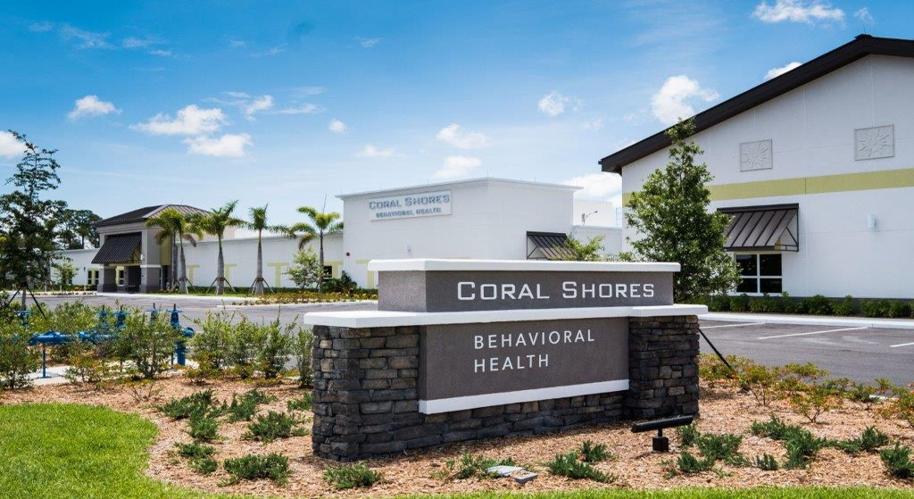
Coral Shores Behavioral Health is a state-of-the-art freestanding psychiatric hospital operating since 2017.
CSBH is located in Stuart, Florida, on the beautiful Treasure Coast, just 30 min North from West Palm Beach.
The facility has 80 Inpatient beds serving children, adolescents, adults and older adults, and offering compassionate treatment through a spectrum of specialized Inpatient Programs.
We offer Crisis Intervention and Stabilization; Medication management; Individual and group counseling; Psychoeducational Groups, Recreational Therapy; Patient and Family Education; Discharge and aftercare planning.
The facility offers Outpatient treatment services that can include Adult PHP, Adult IOP and provides framework for recovery and healing.

Slide 3
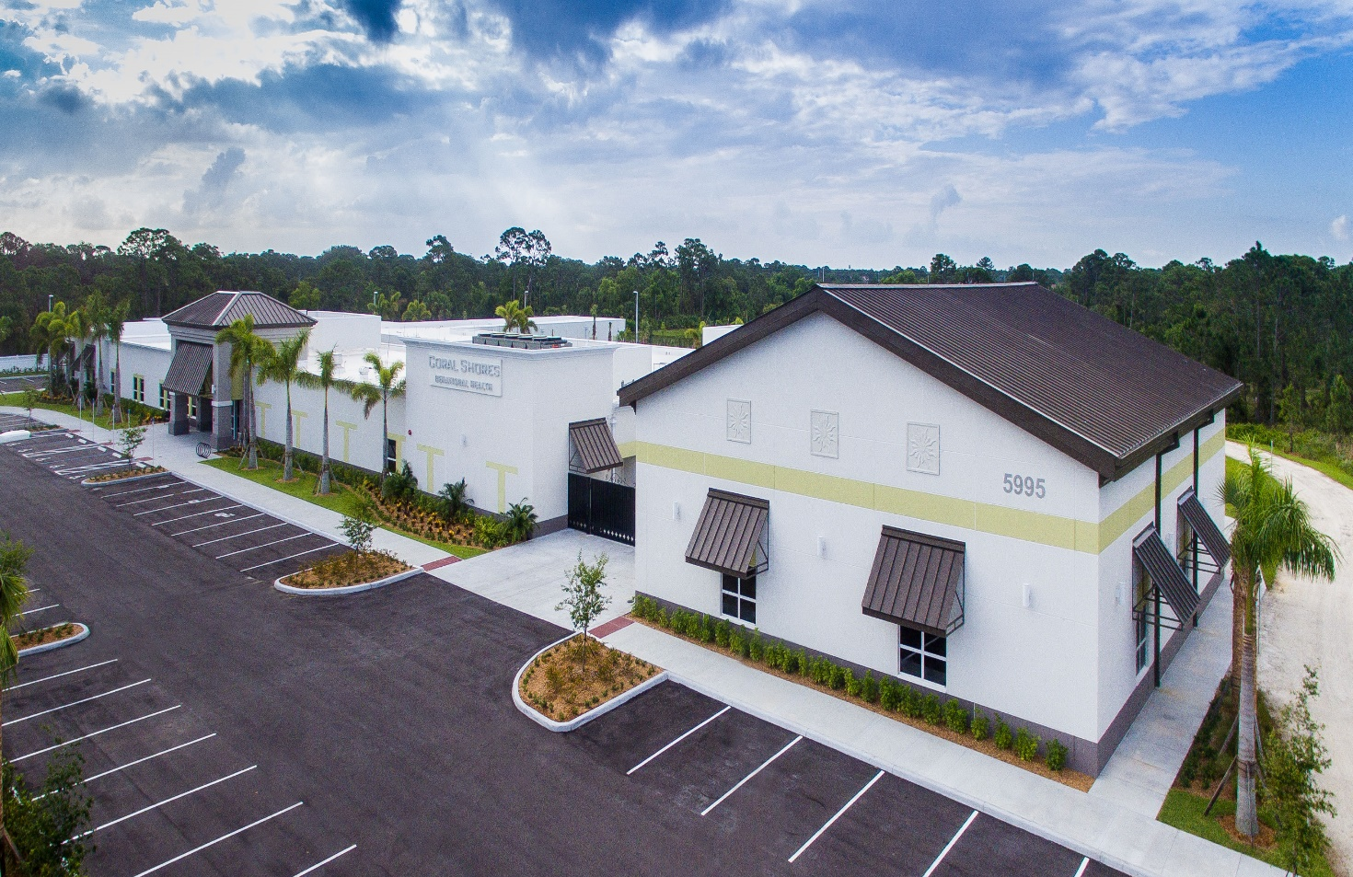
SPECIALIZED INPATIENT PROGRAMS
Adult Program-Promotes cognitive, social, physical and behavioral development.
Adult Dual Diagnosis Program-Helps patients achieve lasting sobriety, while dealing with co-occurring mental illness.
Adult Affective Disorder Program-Supports recovery from depression, bipolar and anxiety disorders.
Mature Adult Program- Designed for older adults who struggle with mental health and co-occurring disorders.
IP programs for Children and Adolescents who struggle with behavioral, mental health or substance use conditions.
OUTPATIENT PROGRAMS
The facility offers outpatient treatment services that can include Adult PHP, Adult IOP and provides framework for recovery and healing.

Slide 4
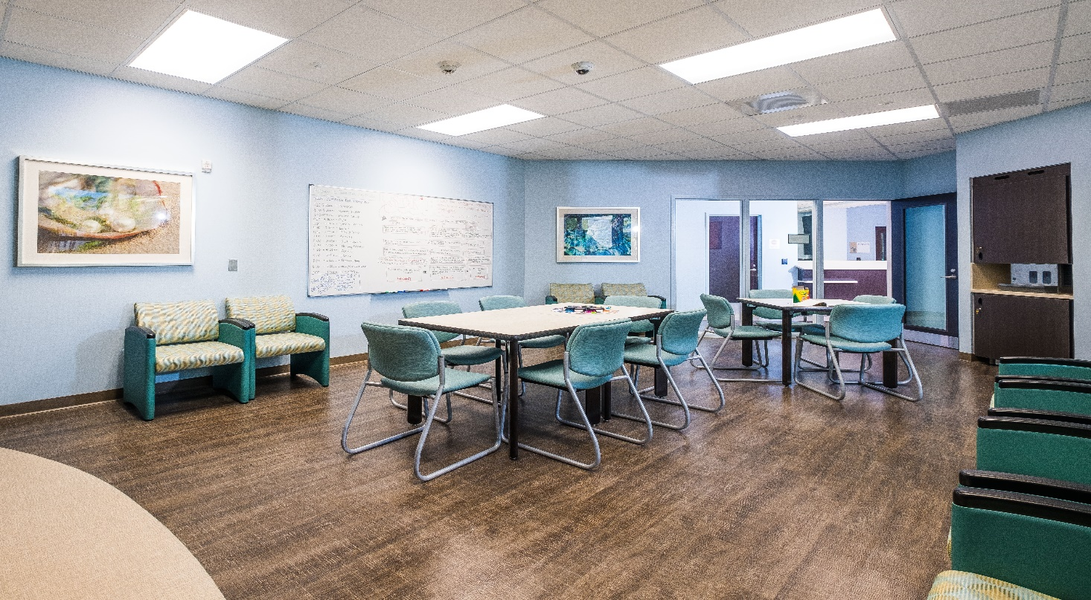
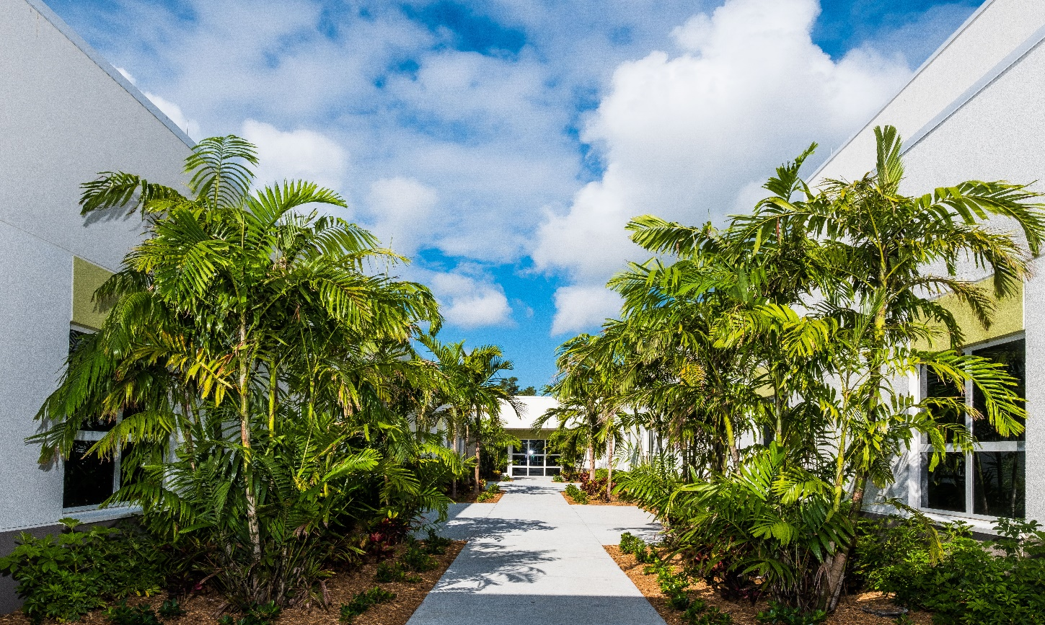
We use patient-centered, evidence-based treatment CONDITIONS WE TREAT INCLUDE
Suicidal Ideation
Depression
Self-harm
Aggressive/impulsive behaviors
Bipolar disorders
Anxiety disorders/agitation
PTSD
Panic disorders
SUD
Personality disorders
Thought disorders and paranoia/fear
Mood disorders

Slide 5
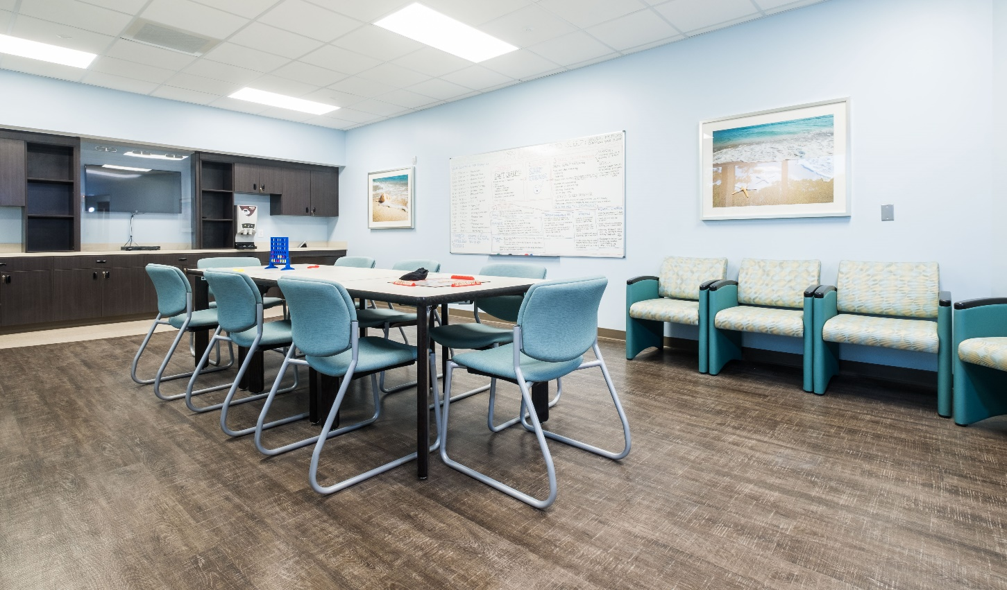
Coral Shores Behavioral Health hospital serves primarily the following counties: Martin County, Palm Beach County, Port St. Lucie, Indian River County, Okeechobee.
Coral Shores Behavioral Health serves a broad geographical area and receives referrals, and admits patients from Broward County, Brevard County as well as from hospitals and providers in the Orlando and Tampa area.
CSBH hospital is the only Baker Act receiving facility in Martin County.

Slide 6
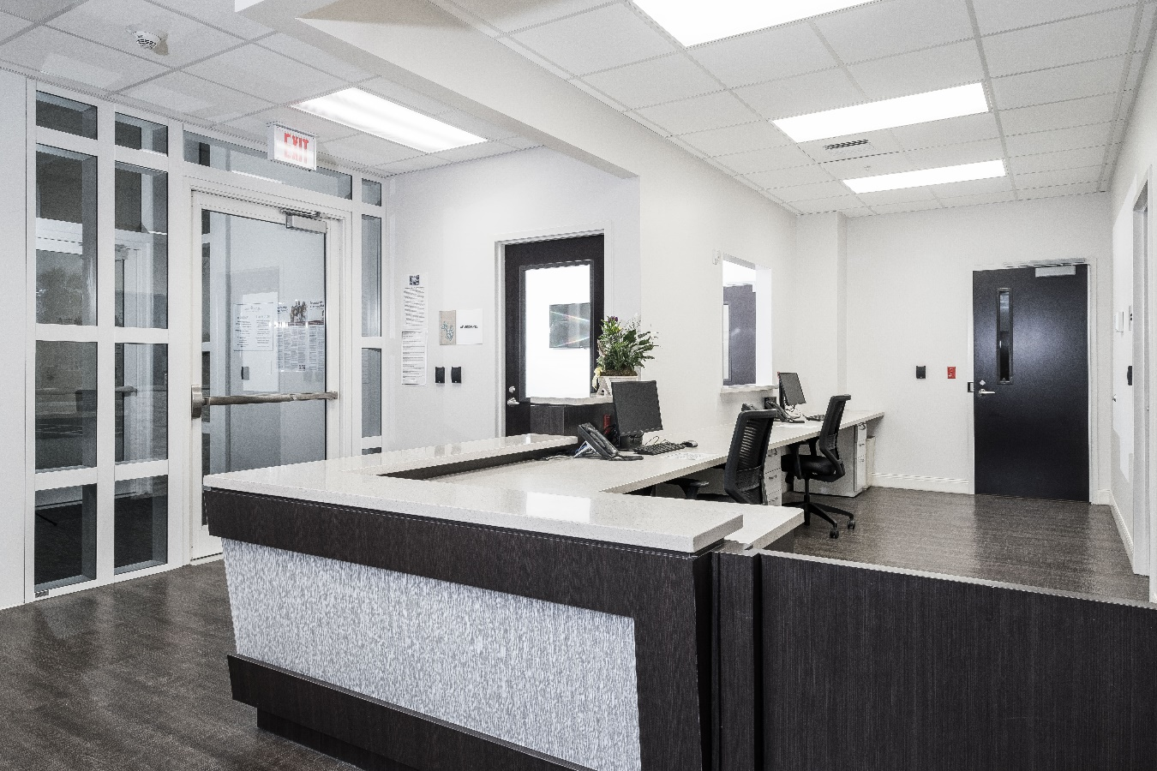
Coral Shores Behavioral Health does not have a waiting list.
We accept patients 24/7/ 365
We provide free assessments by a licensed clinician 24/7/365
For referrals, please call
Main Line (772) 403-4000
24/7 Intake (772) 403-CARE (2273)

Slide 7
Insurances
Coral Shores Behavioral Health accepts most commercial insurances, Medicare, Managed Medicare and Managed Medicaid. We also have a self-pay option, and we do single case agreements including with out-of-state payers to support patients’ needs.
Coral Shores Behavioral Health is does not receive funds to treat the uninsured/underinsured.

Slide 8
Contact information
5995 SE COMMUNITY DR.
STUART, FL 34997
772-403-4000
Or 844-507-9654
Fax:772-361-6231
coralshoresinfo@uhsinc.com
01
REFERRALS AND ADMISSIONS 24/7/365
24/7 Intake
(772) 403-CARE (2273)
02
Kameliya Sapundzhieva
Director of Business Development
C 772 521 0112
Kameliya.sapundzhieva2@uhsinc.com
03

